Slide 1

Slide 1
Stock Market Prediction
Spring 2023 - Capstone Project
Submitted to: Chaojie (Jay) Wang
Submitted by: Anuja Yawar
Devarsh Bhavinkumar Shah

Slide 2

Slide 10
Where would be data science if there was no problem statement?
Developing a machine learning model that can accurately predict the future movements of stock prices, based on historical data and other relevant factors. The model should be able to handle the complexity and volatility of the stock market, and provide reliable predictions for a variety of stocks and indices. The goal is to help investors and financial institutions make informed decisions, minimize risks, and maximize returns in the stock market.
10

Slide 3


Slide 7
OVERVIEW
Step 1
Step 2
Step 3

Slide 4
Slide 5
FRAMEWORK
Gathering Data
Data Exploration
Model
Deployment
Streamlit + Python
Understanding the Structure of data such , variables, data types, missing values,
Univariate Analysis,
Outlier Detection,
Summarizing data by creating visualization
We have gathered the data from Yahoo Finance by fetching the API and saving it in csv to load in pandas
ARIMA
PROPHET
LSTM
5

Slide 5
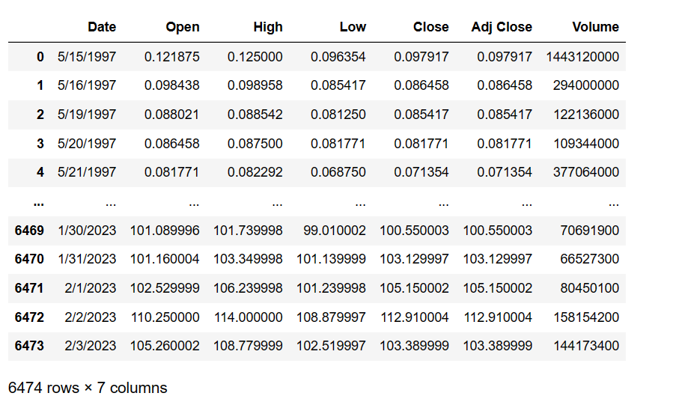
Let’s begin

Slide 6
Information
Open: The opening price is the price of a stock at the beginning of a trading day. It is the price at which the stock starts trading after the market opens.
Close: The closing price is the price of a stock at the end of a trading day. It is the last price at which the stock trades before the market closes.
Volume: Volume refers to the total number of shares that are traded during a trading day. It represents the total amount of buying and selling activity for a stock during a trading day. Let's say that on a particular day, company XYZ's stock had an opening price of $50 and a closing price of $55. During the trading day, a total of 1 million shares of the company's stock were traded. In this case, the volume would be 1 million shares.
Together, open, close, and volume provide valuable information about a stock's performance over time. For example, analyzing the open and close prices can help investors understand how a stock is performing throughout the day, while analyzing the volume can help them understand the level of interest and activity in the stock. By combining these data points with other factors such as company news, macroeconomic conditions, and investor sentiment, analysts can make informed predictions about the future movements of a stock's price.

Slide 7
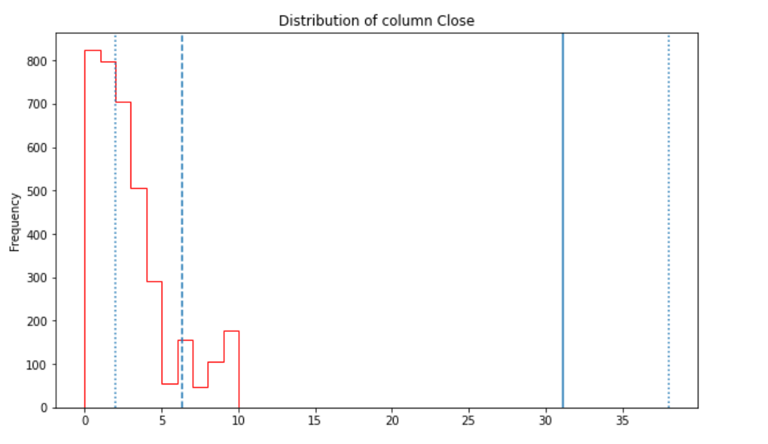
Distribution: ‘Close’
A left-skewed distribution can occur for a variety of reasons, such as the presence of outliers on the low end of the distribution, or a floor effect where data cannot go below a certain value. It is important to understand the nature of the distribution of the data, as this can impact the choice of statistical tests and models used in data analysis.

Slide 8
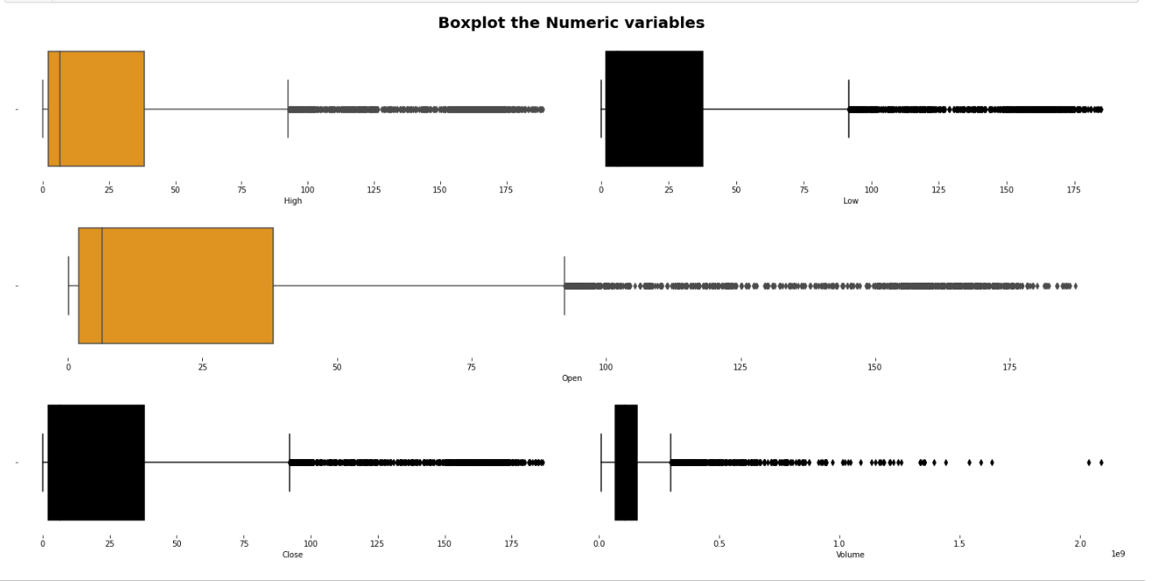
Anomalies

Slide 9
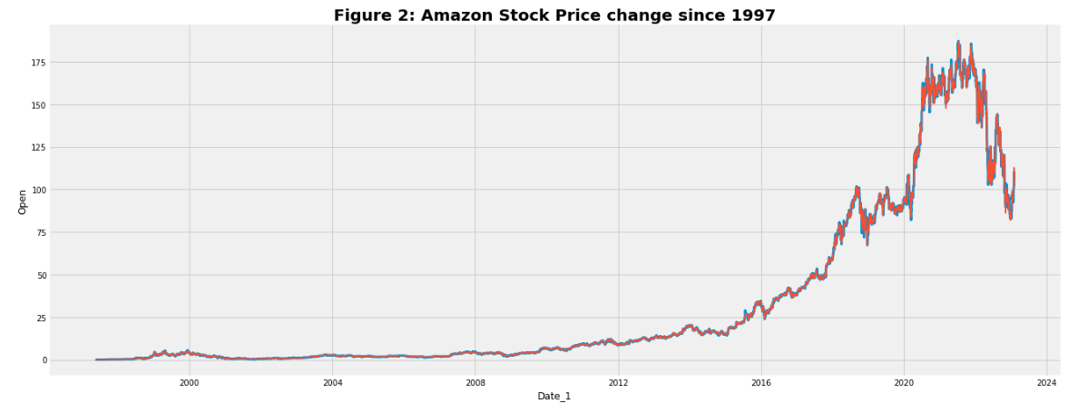
Amazon Stock Historical Trend
Evidently, Amazon business bloomed after year 2010 and peaked after year 2015

Slide 10
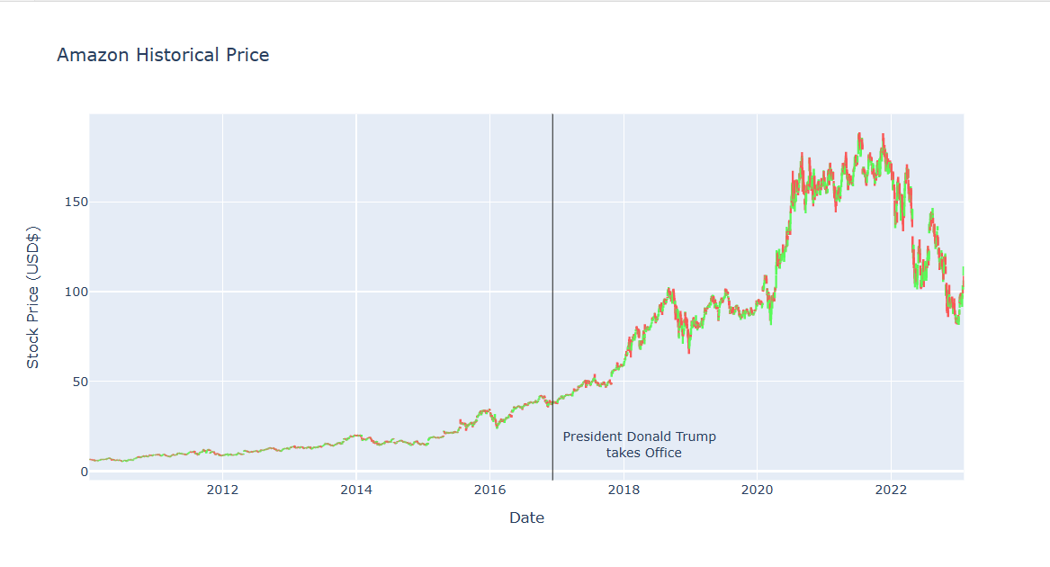
Closer look at the Trend

Slide 11
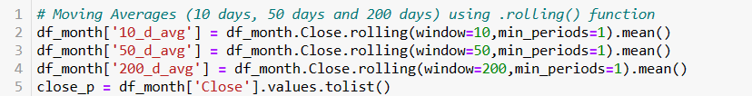
Moving Average
A moving average is a metric often used in technical analysis. For a stock, it’s a constantly updated average price. Unlike trying to track a stock price day-to-day, a moving average smooths price volatility and is an indicator of the current direction a price is headed.
There are multiple ways of calculating moving average in python. For instance, using NumPy .Convolve() function, Pandas' .rolling() method or by creating a function.

Slide 12
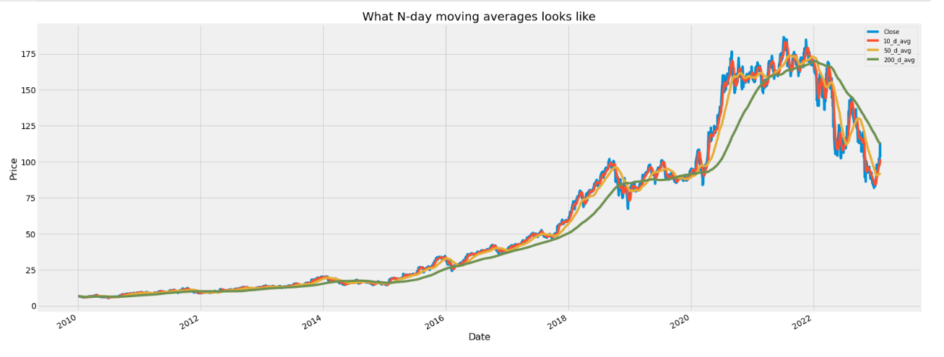
Visualizing Moving Average

Slide 13
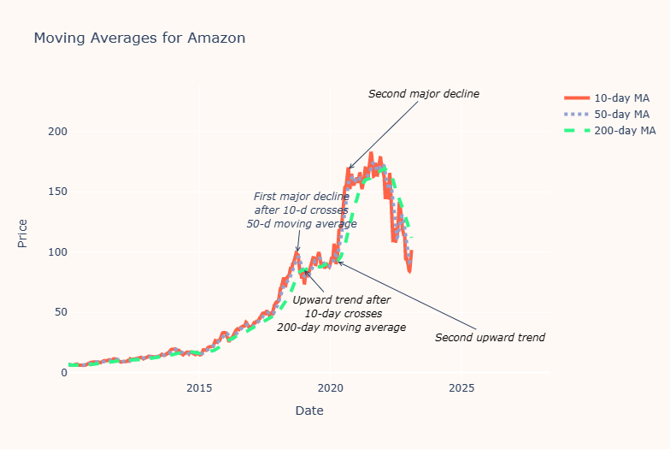
Amazon Stock: Moving Average

Slide 14
Possible Reasons for the Trend
Antitrust concerns: In October 2020, the United States Department of Justice (DOJ) filed a lawsuit against Google, alleging antitrust violations. This raised concerns among investors that other large tech companies, including Amazon, could also face antitrust scrutiny.
Weaker-than-expected Q3 earnings: Amazon's Q3 2020 earnings report, released in October, showed a lower-than-expected revenue growth rate. Although the company reported strong sales figures, there were concerns among investors that the growth rate was slowing down.
Economic uncertainty: The COVID-19 pandemic continued to impact the global economy, leading to uncertainty and volatility in the stock market. This could have contributed to a decline in Amazon's stock price, along with that of other companies.
Delayed Prime Day: Amazon's annual Prime Day event was delayed from its usual July date to October 2020 due to the pandemic. While the event ultimately proved successful, the delay could have led to lower Q3 revenue figures, which could have affected investor confidence.
Executive leadership changes: In February 2021, Jeff Bezos announced that he would step down as CEO of Amazon. While he remained involved with the company as executive chairman, the announcement could have led to uncertainty among investors about the company's future direction.
Economic conditions: Economic conditions, such as inflation, interest rates, and unemployment, can impact consumer spending and investor confidence. Any negative changes to economic conditions could lead to a decline in Amazon's stock price, as well as that of other companies.

Slide 15

Machine Learning Models
ARIMA
PROPHET
LSTM

Slide 16
ARIMA
ARIMA stands for Autoregressive Integrated Moving Average. It is a time series forecasting model that combines autoregression (AR), differencing (I), and moving average (MA) components to make predictions about future values in a time series.
The AR component models the relationship between an observation and a lagged observation in the time series. The MA component models the error term, which is the difference between the predicted value and the actual value at each time step. The I component involves differencing the time series data to make it stationary, meaning it has a constant mean and variance over time.
To implement ARIMA, you need to specify three parameters: p, d, and q. These represent the order of the AR, I, and MA components, respectively. The p parameter specifies the number of lags to include in the AR component, while the q parameter specifies the number of error terms to include in the MA component. The d parameter specifies the number of times the time series needs to be differenced to achieve stationarity.

Slide 17
How to find values of p, q, d ?
Before moving to that there is a fundamental concept to be understood: Time serious data only works with Stationary data.
Stationary! Ugh, what does this mean? Let's us briefly understand the math.
Stationary data that the property that the mean, variance, and autocorrelation structure do not change over time.
If both mean and standard deviation are flat lines(constant mean and constant variance), the series becomes stationary.
Pre-requisite for Stationary Dataa
Mean should be constant
Standard deviation should be constant
How can we achieve this in python?
Using rolling statistics
Dickey Fuller test

Slide 18
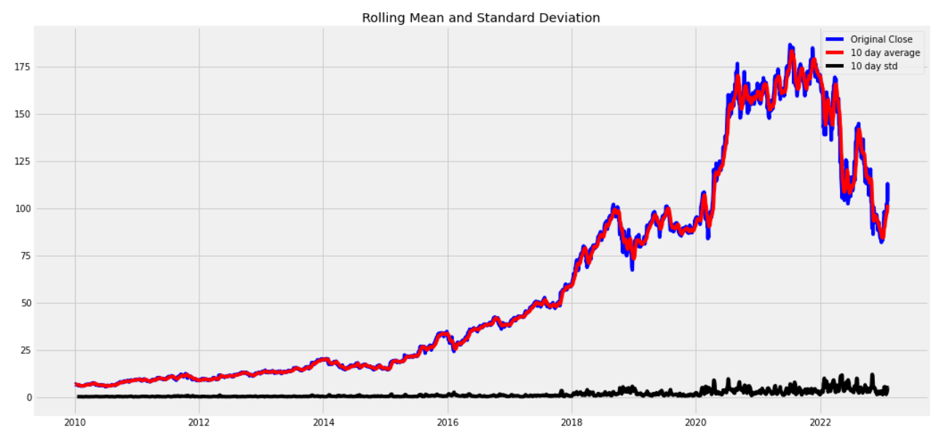
Approach 1: Rolling Statistics

Slide 19
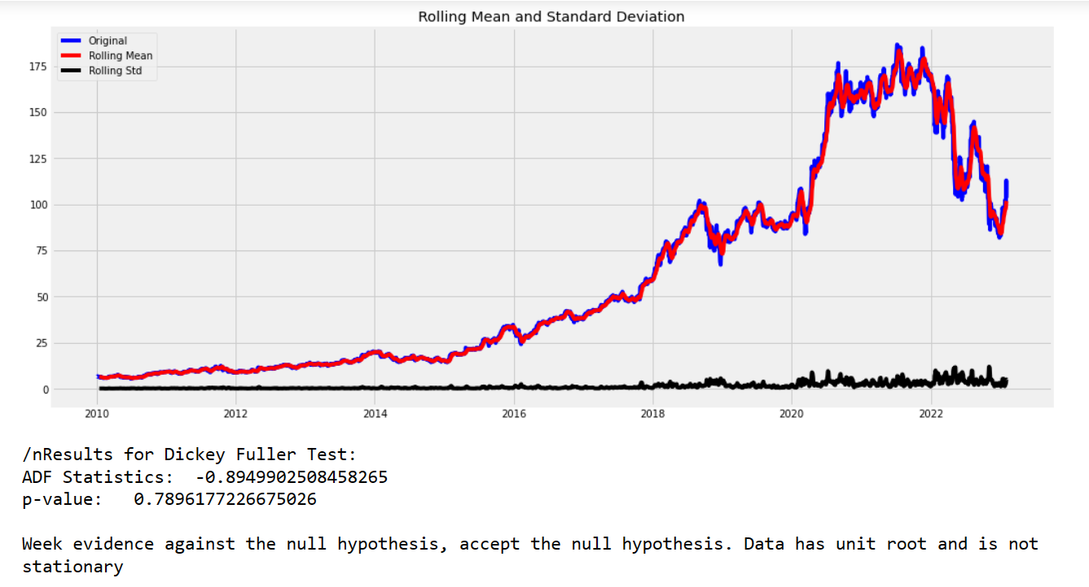
Approach 2: Dickey Fuller Test

Slide 20
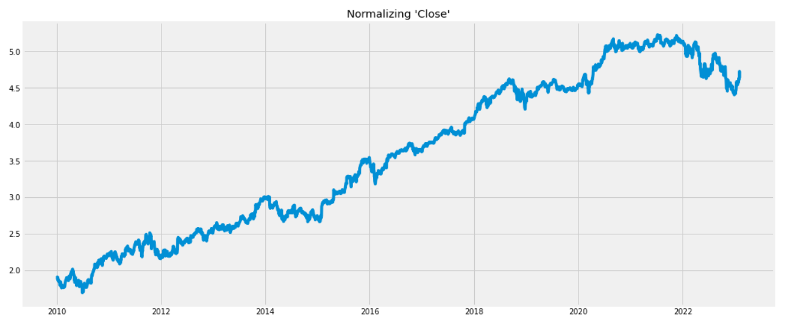
How can we make data Stationary?
We can take log transformation, square root transformation, q transformation. We do not know which transformation will make the data stationary

Slide 21
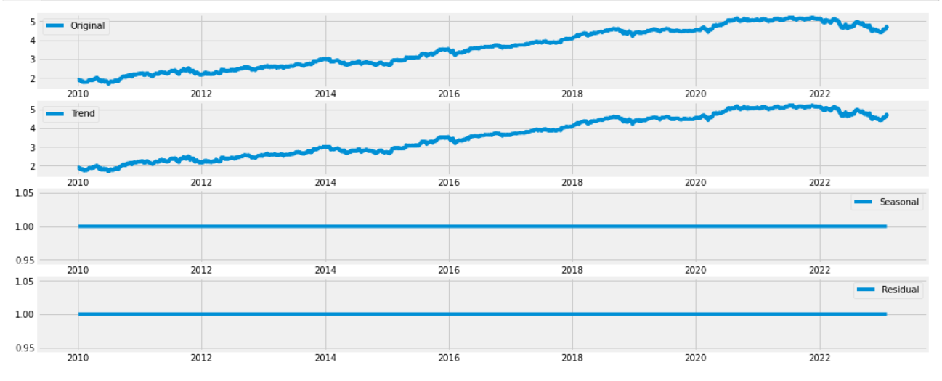
Full proof Confirmation

Slide 22
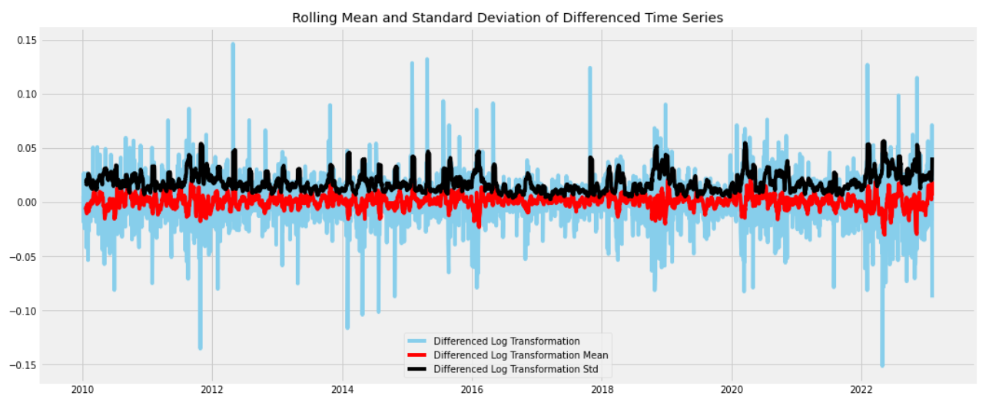
Differencing AR(I)MA
Only after first differencing we fulfilled the requirements. Therefore, d = 1

Slide 23
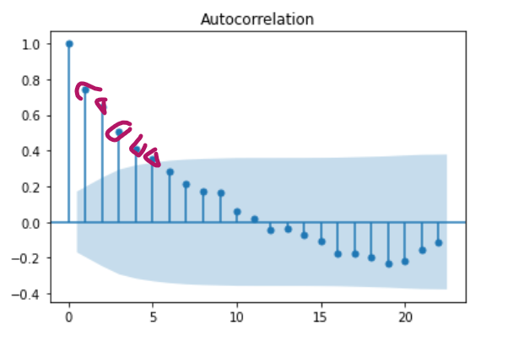
P and Q Values
1. Approach 1: ACF and PACF
functions
2. Approach 2: AUTO_ARIMA() function
The values of p and q can be determined using various methods, such as the autocorrelation function (ACF) and the partial autocorrelation function (PACF). These functions are used to identify the presence of correlation in the time series at various lags. The ACF and PACF plots can help determine the appropriate values of p and q for the ARIMA model.

Slide 24
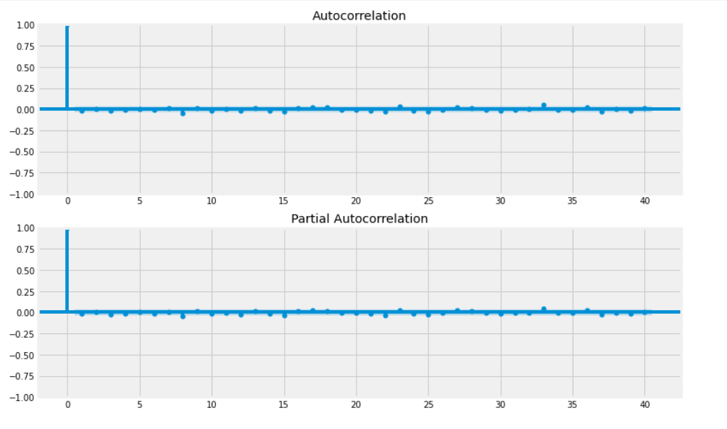
Approach 1: ACF and PACF
In our case, p and q values are zero. So, far we have d=1, p=0 and q=0

Slide 25
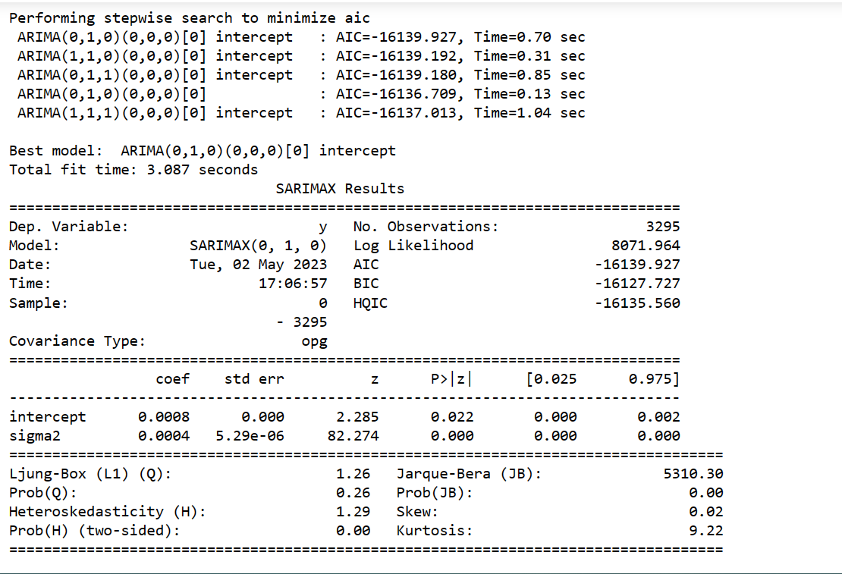
APPROACH 2:

Slide 26
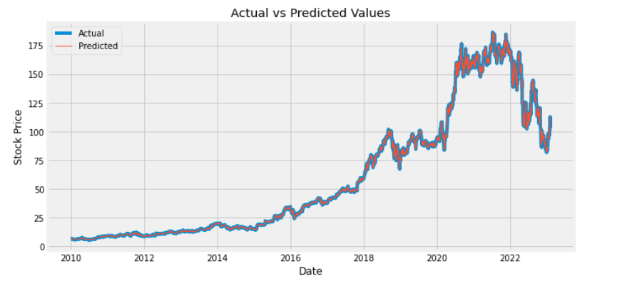
Actual vs Predicted

Slide 27
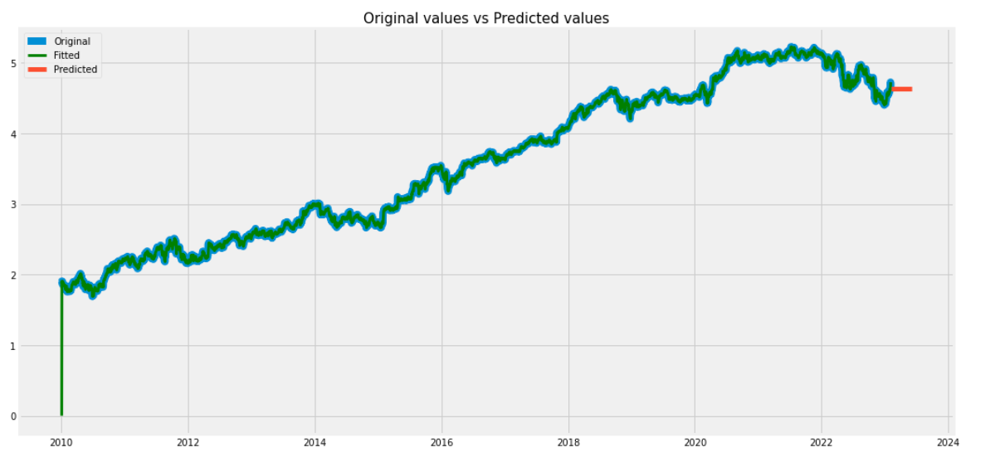
Future 60 days prediction
Root Mean Square: 0.07113827935692238

Slide 28
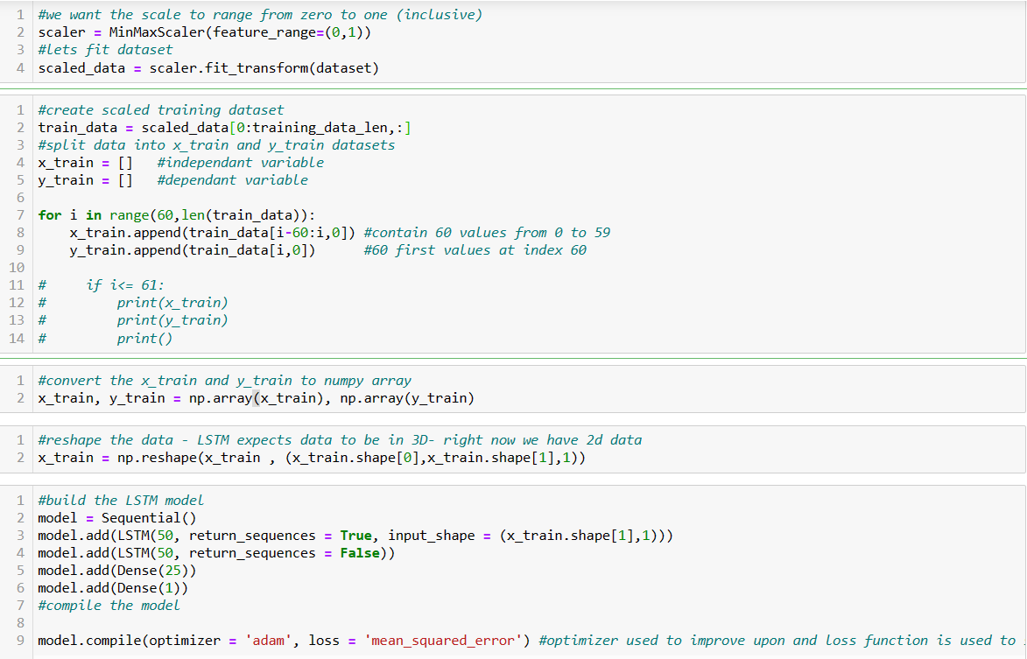
LSTM: Long Short Term Memory

Slide 29
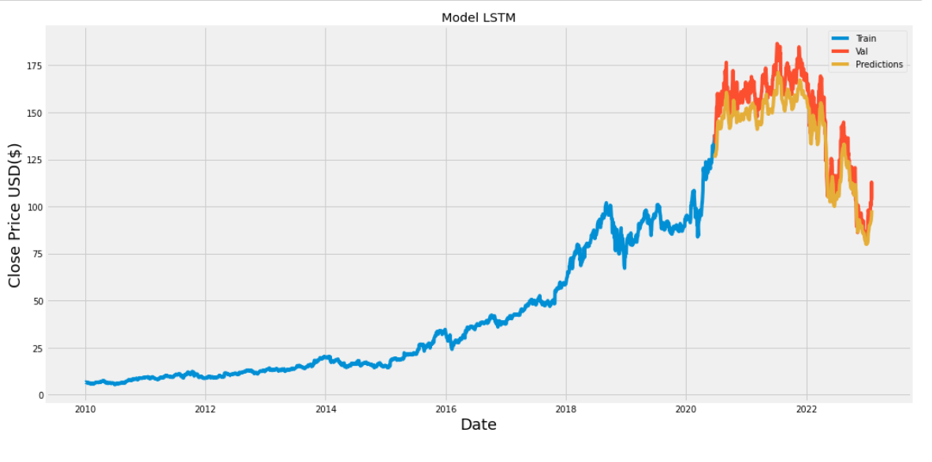
Predicted vs Ground Truth
Root Mean Square Error: 9.39

Slide 30
PROPHET
We have also implemented another model called Prophet but it is directly implemented in Streamlit.
Prophet is open source software released by Facebook’s Core Data Science team.
Prophet is a procedure for forecasting time series data based on an additive model where non-linear trends are fit with yearly, weekly, and daily seasonality, plus holiday effects. It works best with time series that have strong seasonal effects and several seasons of historical data. Prophet is robust to missing data and shifts in the trend, and typically handles outliers well.

Slide 31
Deployment
Streamlit + Python

Slide 32
What did we learn?
One key lesson is that stock market prediction is an extremely difficult task. While historical trends and patterns can be useful indicators, the stock market is influenced by a multitude of unpredictable factors, such as economic conditions, geopolitical events, and natural disasters, among others. This complexity makes it challenging to accurately predict stock market trends over the long-term, and even short-term predictions can be subject to significant uncertainty.
Another important insight is that data analysis and machine learning techniques can be valuable tools for making informed investment decisions. By analyzing historical stock data and identifying patterns, investors can gain insights into market trends and make more informed decisions about when to buy or sell stocks. However, it is important to recognize that no model is perfect, and even the most advanced machine learning algorithms have limitations and potential sources of error. Investors should always use caution and conduct thorough research before making investment decisions.

Slide 33

Slide 11
THANK YOU

